Slide 1
Art from the Harlem Renaissance
OPTIC Analysis

Slide 2
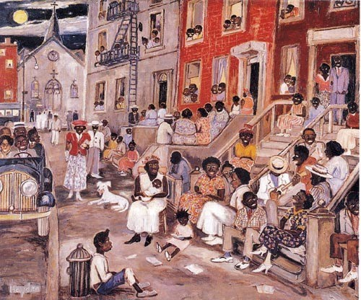
Palmer C. Hayden, Midsummer Night in Harlem, 1938, oil on canvas.

