Slide 1
Persuasive Techniques & Rhetorical Appeals
Adapted from www.henryk12.net/middleton/wp-content/uploads/.../Persuasive-PPT.ppt

Slide 2
Bandwagon Technique
Everyone is doing something, so you should, too!

Slide 3
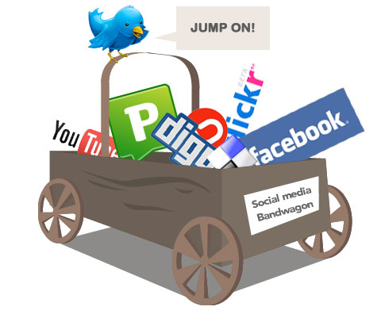
The bandwagon effect ...

Slide 4
Bandwagon (cont.)

Slide 5
Bandwagon (cont.)

Slide 6
Loaded Words and Glittering Generalities
Loaded Words = Words that will make you feel strongly about someone or something (fear, desire for success, excitement, being part of a group).
Loaded Words can be Glittering Generalities
Glittering Generalities = Words that “glitter” but give no details about the product.
“NEW and IMPROVED”

Slide 7
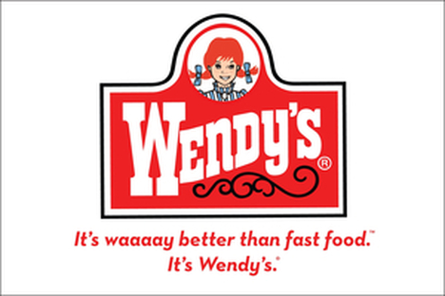
Glittering Generalities (cont.)

Slide 8
Glittering Generalities (cont.)

Slide 9
Fear
Used to convince someone to act based on negative consequences if they do not

Slide 10
Fear (cont.)
Observer special report
After six deaths in the US and bans around the world – is vaping safe?

Slide 11
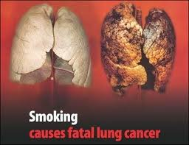
Fear (cont.)

Slide 12
Name Calling
Bad names will cause people to construct a negative opinion about a person, group, etc.

Slide 13
Name Calling (cont.)

Slide 14
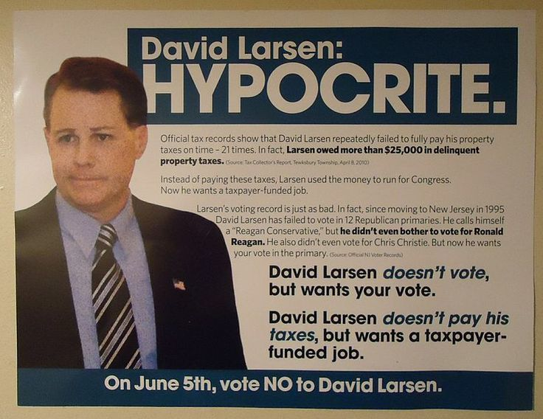
Name Calling (cont.)

Slide 15
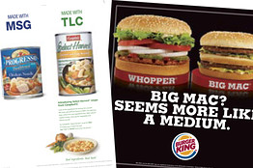
Name Calling (cont.)

Slide 16
Testimonial
A well-known person or a previous customer supports or endorses something (e.g., a product)

Slide 17
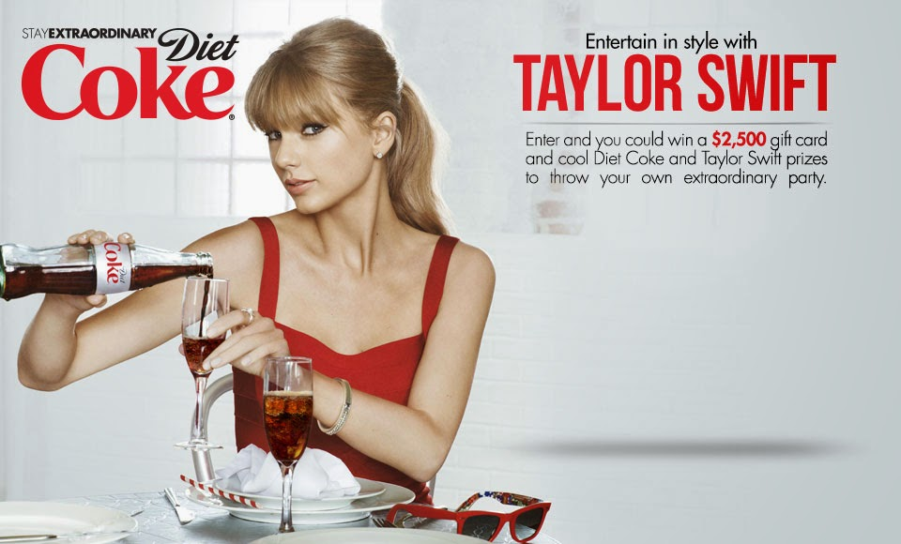
Testimonial (cont.)

Slide 18
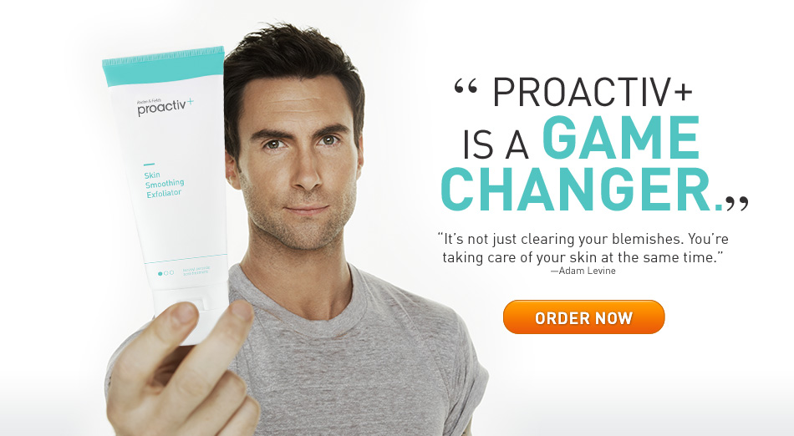
Testimonial (cont.)

Slide 19
Limited Opportunity
Time is running out, so act quickly!

Slide 20
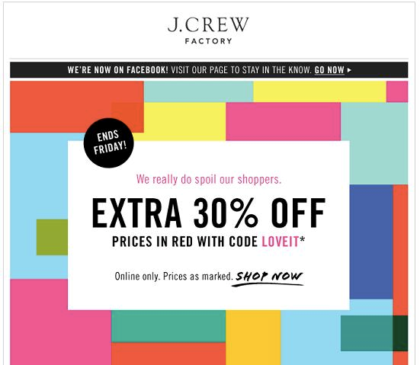
Limited Opportunity (cont.)

Slide 21
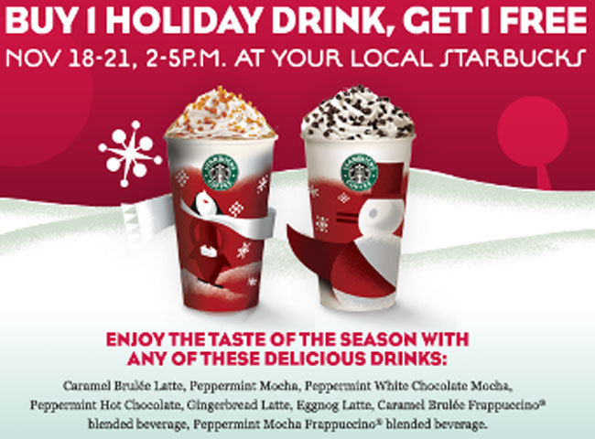
Limited Opportunity (cont.)

Slide 22
Repetition
Restating an idea using the same words

Slide 23
Restatement
Expressing the same idea in different words

Slide 24
Parallelism
Repeating grammatical structures

Slide 25
Antithesis
Using strongly contrasting words, images, ideas

Slide 26
Rhetorical Question
Asking questions with obvious answers

